Slide 1
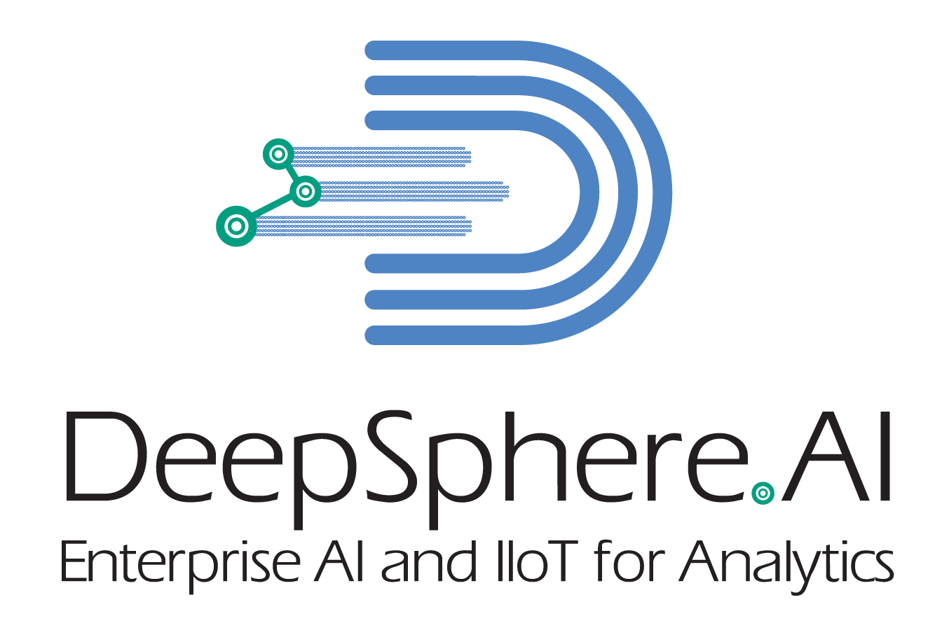
Working with SQL Statement in Python
SQL in Python Programming
Step #1
Install MySQL Connector Libraries
Step #2
Import MYSQL Connector Libraries
Step #3
Connect to the MYSQL Database using the MYSQL Connector Libraries and its functions
Step #4
Create a Cursors
Step #5
Execute the SQL statement
USA | Singapore
©DeepSphereAI.SG 2021 | Confidential & Proprietary

Slide 2
Working with SQL Statement in Python
SQL in Python Programming
Step #5
Execute the SQL statement
Step #6
Fetch the results from the cursor
Step #7
Review the SQL statement outcome
USA | Singapore
©DeepSphereAI.SG 2021 | Confidential & Proprietary

Slide 3
What SQL Statement we can execute via Python
All SQL Statements
DDL
SELECT
DML
DCL
Create
Alter
Drop
Truncate
SELECT
Insert
Update
Delete
Commit
Rollback
USA | Singapore
©DeepSphereAI.SG 2021 | Confidential & Proprietary

Slide 4
Error Handling
import mysql.connector
try:
cnx = mysql.connector.connect(user=‘JOTHI', database=‘LVA')
cursor = cnx.cursor()
cursor.execute("SELECT * FORM employees") # Syntax error in query
cnx.close()
except mysql.connector.Error as err:
print("Something went wrong: {}".format(err))
USA | Singapore
©DeepSphereAI.SG 2021 | Confidential & Proprietary

Slide 5
Error Handling
import mysql.connector
from mysql.connector import errorcode
cnx = mysql.connector.connect(user='scott', database='test')
cursor = cnx.cursor()
try:
cursor.execute("DROP TABLE spam")
except mysql.connector.Error as err:
if err.errno == errorcode.ER_BAD_TABLE_ERROR:
print(“Dropping a table which does not exist")
else:
raise
USA | Singapore
©DeepSphereAI.SG 2021 | Confidential & Proprietary

Slide 6
Error Handling
# error number
# SQLSTATE value
# error message
USA | Singapore
©DeepSphereAI.SG 2021 | Confidential & Proprietary

Slide 7
On the Spot Quiz
Using the Python My SQL Connector, perform the following task.
#1- Execute this select statement - SELECT * FROM customer_churn where state='KS' and churn like 'TRUE%’;
#2- Fetch the record and print it on the console
#3- Handle Table Does not exist error
Time 10 -15 Min
Write the function as a standalone function with no arguments and return either success or failure based on SQL error handling. If no SQL error is found, it returns success; otherwise, it fails.
# Create a Connection to MySQL
mydb = mysql.connector.connect(user='root',database="lva", password='01012001', host='34.30.129.74')
USA | Singapore
©DeepSphereAI.SG 2021 | Confidential & Proprietary

Slide 8
Matplotlib vs. Seaborn
Data visualization in Python, three libraries stand out: Matplotlib, Seaborn, and Plotly. Each of these libraries has its strengths and unique features, making them suitable for various data visualization needs.
Matplotlib
Seaborn
Plotly
USA | Singapore
©DeepSphereAI.SG 2021 | Confidential & Proprietary

Slide 9
Data Visualization
Why people
What is the difference between a report and data visualization
When to use the dashboard
Who needs dashboard and data visualization
List of the executive’s analytics
List some of the Operational analytics
List some of the strategic analytics
USA | Singapore
©DeepSphereAI.SG 2021 | Confidential & Proprietary

Slide 10
Matplotlib vs. Seaborn
Matplotlib is a foundational library that provides a comprehensive set of tools for creating a wide range of static, interactive, and animated visualizations. It’s highly versatile and can be used to create everything from basic line and bar plots to complex visualizations.
Pros:
Cons:
Use Cases:
Offers extensive customization options for visualizations.
Provides fine-grained control over plot aesthetics and styles.
Supports a wide variety of plot types and chart configurations.
Requires writing more code to achieve certain types of visualizations.
Has a steeper learning curve due to its granular syntax.
Basic line, bar, and scatter plots.
Customizing plot aesthetics and styles. (change the visual appearance)
Creating complex visualizations with precise control. (National unemployment, Job Gains, and Job Losses)
USA | Singapore
©DeepSphereAI.SG 2021 | Confidential & Proprietary

Slide 11
Matplotlib vs. Seaborn
Seaborn is built on top of Matplotlib and aims to simplify the creation of informative and attractive statistical graphics. It provides a higher-level interface for creating complex visualizations with ease.
Pros:
Cons:
Use Cases:
Offers built-in themes and color palettes for aesthetically pleasing visualizations.
Simplifies the creation of advanced statistical plots like box plots and violin plots.
Provides support for visualizing multivariate relationships.
While easier to use than Matplotlib, it may have limitations for highly custom visualizations.
Creating box plots, violin plots, and other advanced statistical plots.
Generating heatmaps and correlation matrices.
Visualizing multivariate relationships with pair plots.
USA | Singapore
©DeepSphereAI.SG 2021 | Confidential & Proprietary

Slide 12
Matplotlib vs. Seaborn
Distplot (Seaborn Distplot)
Distribution plots visually assess the distribution of sample data by comparing the empirical distribution with the theoretical values expected from a specified distribution.
A distplot plots a univariate distribution of observations.
Seaborn distplot lets you show a histogram with a line on it. This can be shown in all kinds of variations. We use seaborn in combination with matplotlib, the Python plotting module.
USA | Singapore
©DeepSphereAI.SG 2021 | Confidential & Proprietary

Slide 13
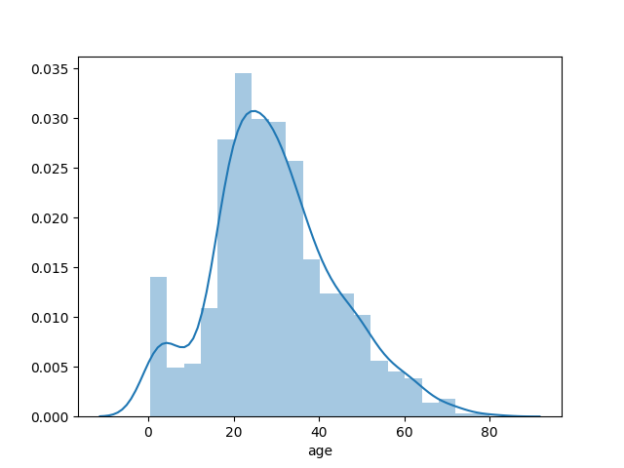
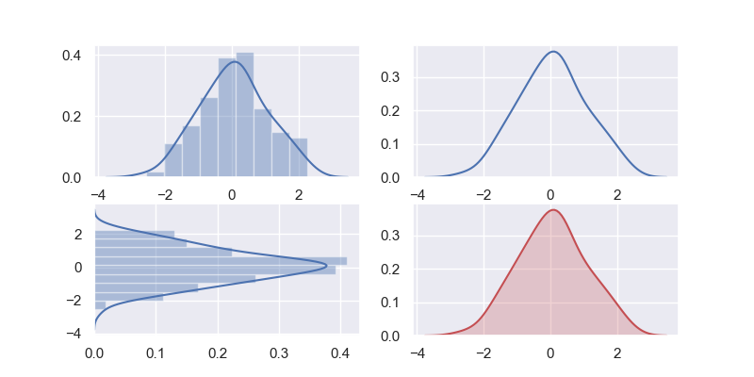
Matplotlib vs. Seaborn
Distplot (Seaborn Distplot)
Subplots () Create a grid of subplots within a single figure
USA | Singapore
©DeepSphereAI.SG 2021 | Confidential & Proprietary

Slide 14
Seaborn
Advantages of using Seaborn
Extensive Gallery of examples:
Active community and documentation:
Flexibility and customization:
Ease of use:
Built-in statistical functionality:
Cross-platform compatibility:
Continuous development and updates:
Integration with other libraries:
Support for both complex and basic plots:
USA | Singapore
©DeepSphereAI.SG 2021 | Confidential & Proprietary

Slide 15
Tips for Effective Visualization
Understand your data:
Choose the right plot type:
Keep it simple:
Use color purposefully:
Provide context and annotations:
Experiment and iterate:
Seek feedback:
USA | Singapore
©DeepSphereAI.SG 2021 | Confidential & Proprietary

Slide 16
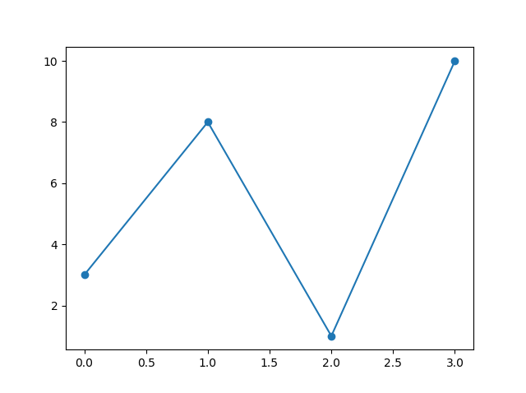
Tips for Effective Visualization
Markers
You can use the keyword argument marker to emphasize each point with a specified marker:
USA | Singapore
©DeepSphereAI.SG 2021 | Confidential & Proprietary

Slide 17
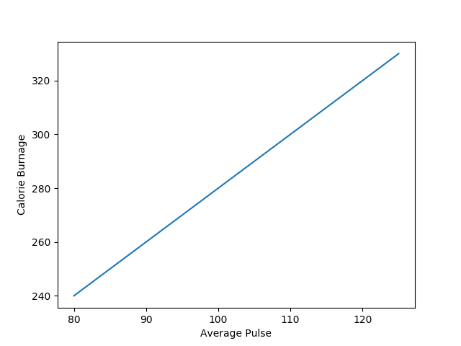
Tips for Effective Visualization
Labels
you can use the xlabel() and ylabel() functions to set a label for the x- and y-axis.
USA | Singapore
©DeepSphereAI.SG 2021 | Confidential & Proprietary

Slide 18
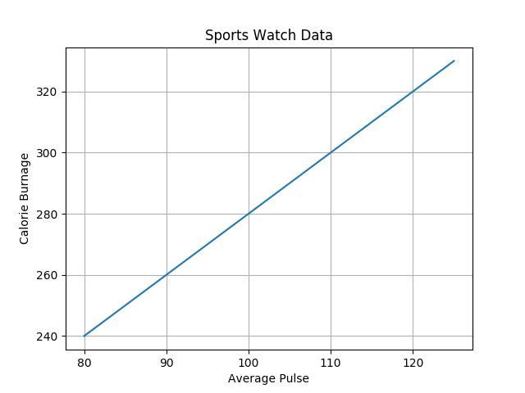
Tips for Effective Visualization
Grid Lines to a Plot
you can use the grid() function to add grid lines to the plot.
Grid Line
USA | Singapore
©DeepSphereAI.SG 2021 | Confidential & Proprietary

Slide 19
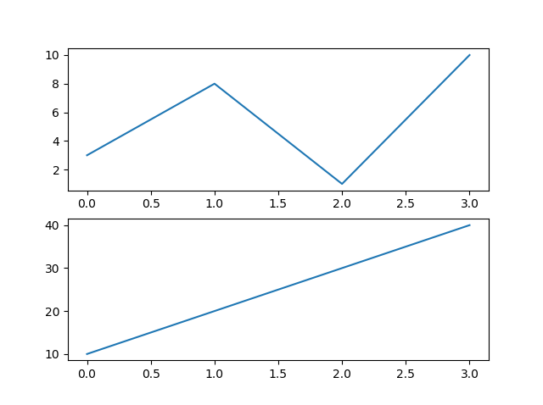
Tips for Effective Visualization
subplot() – N-Dimensional Analysis
you can draw multiple plots in one figure:
Ex: Looking at sales at multiple different dimensions
USA | Singapore
©DeepSphereAI.SG 2021 | Confidential & Proprietary

Slide 20
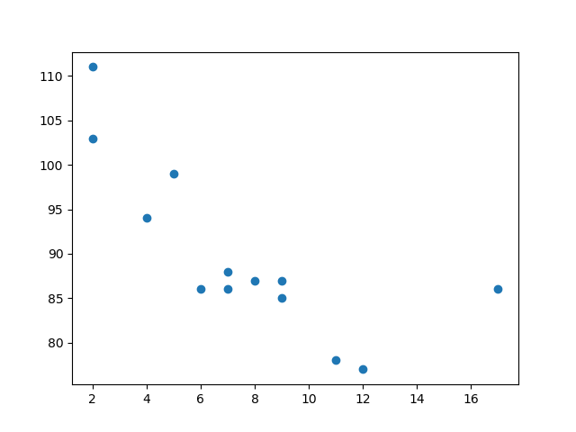
Tips for Effective Visualization
Scatter Plots
The scatter () function plots one dot for each observation. It needs two arrays of the same length, one for the values of the x-axis and one for values on the y-axis:
To display the relationship between two variables and observe the nature of such a relationship. The relationships observed can either be positive or negative, non-linear or linear, and/or strong or weak.
Example Number of Store visits vs. Amount Spend
USA | Singapore
©DeepSphereAI.SG 2021 | Confidential & Proprietary

Slide 21
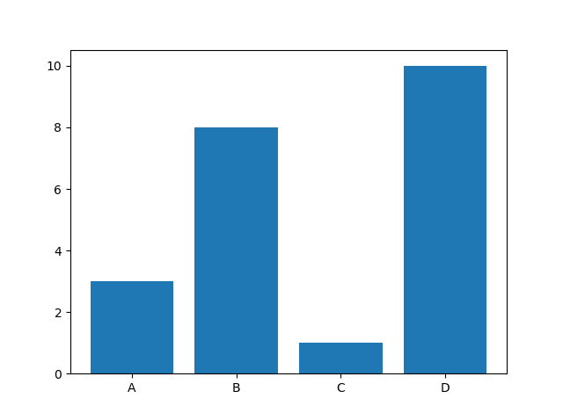
Tips for Effective Visualization
Bars
use the bar() function to draw bar graphs:
USA | Singapore
©DeepSphereAI.SG 2021 | Confidential & Proprietary

Slide 22
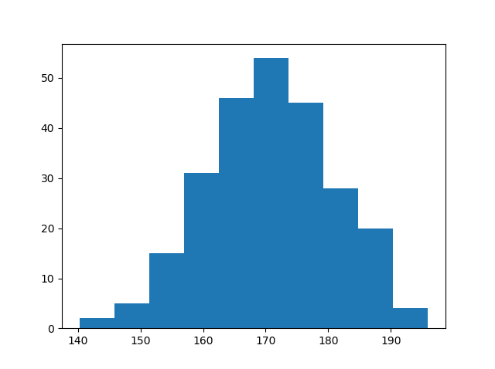
Tips for Effective Visualization
Histogram
showing frequency distributions.
Ex: Customer visit to a retail store by days
USA | Singapore
©DeepSphereAI.SG 2021 | Confidential & Proprietary

Slide 23
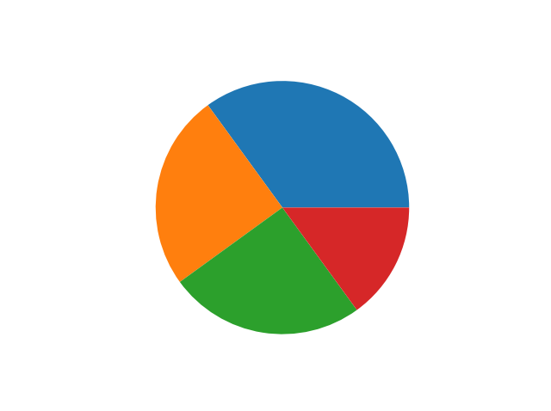
Tips for Effective Visualization
Pie Charts
use the pie() function to draw pie charts:
USA | Singapore
©DeepSphereAI.SG 2021 | Confidential & Proprietary

Slide 24
On the Spot Quiz
Time 10 -15 Min
Create an appropriate chart showing sales distribution by channel using a CSV file.
The function should be a standalone function that takes a data frame as an argument and prints the chart upon calling it
USA | Singapore
©DeepSphereAI.SG 2021 | Confidential & Proprietary

Slide 25
On the Spot Quiz
On the Spot Quiz
Time 10 -15 Min
Create a chart showing which major city in Chennai has the highest number of diabetic patients. Use an appropriate Python data structure as a data source.
The function should be a standalone function that takes a Python data structure as an argument and prints the chart when called.
USA | Singapore
©DeepSphereAI.SG 2021 | Confidential & Proprietary

Slide 26
Today’s (03/18/2024) Topics
DF - Advanced Topics
EDA
EDA with Charts and Graphs
SQL Through Python
USA | Singapore
©DeepSphereAI.SG 2021 | Confidential & Proprietary

Slide 27
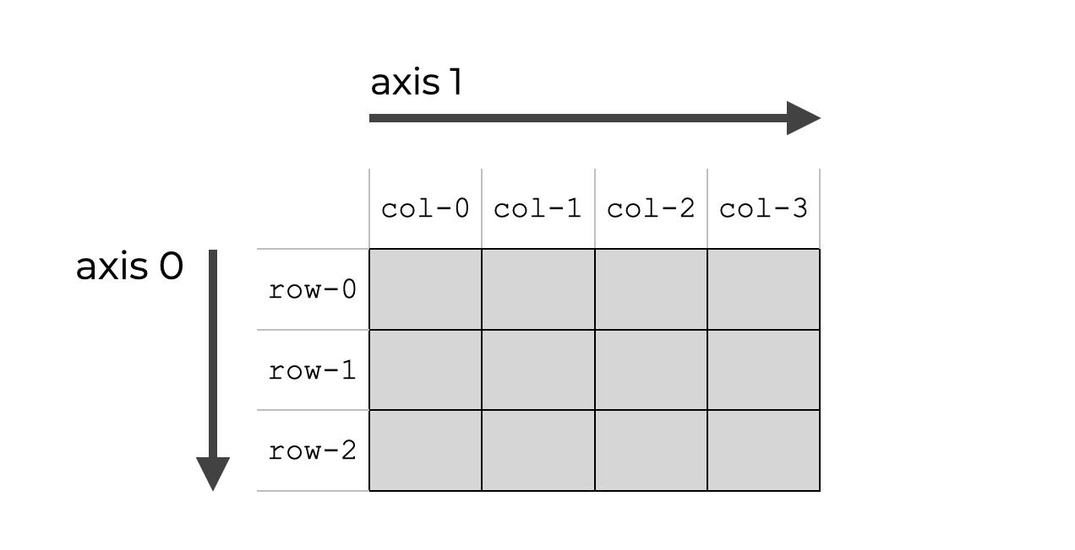
DF Axis
USA | Singapore
©DeepSphereAI.SG 2021 | Confidential & Proprietary

Slide 28
vAR_sum = df[['COURSES-FEE','COURSES-DSICOUNT']].aggregate('min’)
All courses
=========================================
vAR_sum = df.groupby('COURSES')['COURSES-FEE','COURSES-DSICOUNT'].aggregate('sum’)
Each course and one AGG function
===============================================================
result = df.groupby('COURSES').aggregate({'COURSES-DURATION':'count','COURSES-FEE':['min','max’]})
Each course and MULTIPLE AGG function

Slide 29
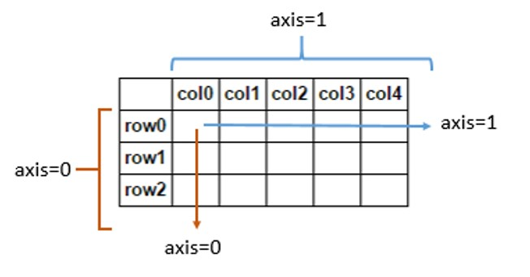
DF Axis
USA | Singapore
©DeepSphereAI.SG 2021 | Confidential & Proprietary

Slide 30
Exploratory Data Analysis (EDA)
Reading dataset
Analyzing the data
Checking for the duplicates
Missing Values Calculation
Exploratory Data Analysis
Univariate Analysis
Bivariate Analysis
Multivariate Analysis
What is Preprocessing and Data Engineering?
USA | Singapore
©DeepSphereAI.SG 2021 | Confidential & Proprietary

Slide 31
Exploratory Data Analysis (EDA)
EDA is a vital step in the data analysis process that entails visually and statistically analyzing datasets to find patterns, trends, and insights.
The principal goals of exploratory data analysis (EDA) are to detect anomalies in the dataset and develop recommendations for additional investigation, thereby guaranteeing a thorough comprehension of the data’s subtleties.
To obtain a comprehensive understanding of the data, analysts use various EDA approaches, including summary statistics, correlation analysis, and data visualization using tools like box plots, scatter plots, and histograms.
EDA provides insightful information that helps with hypothesis creation and decision-making by improving knowledge of data distribution, variable correlations, and anomalies. In the end, EDA’s capacity to identify trends and anomalies enhances the efficacy of data-driven projects.
USA | Singapore
©DeepSphereAI.SG 2021 | Confidential & Proprietary

Slide 32
Exploratory Data Analysis (EDA)
# importting Libraries
import pandas as pd
import numpy as np
import matplotlib.pyplot as plt
import seaborn as sns
import warnings as wr
wr.filterwarnings('ignore’)
df = pd.read_csv("winequality-red.csv")
print(df.head())
df.shape # Rows, and Columns
df.info() # Column , Data Type, Null or Not Null
df.describe() # Count, Mean, STD, MIN
df.columns.tolist()# Column List
df.isnull().sum() # missing values
df.nunique() #checking duplicate values
df['Spend'].value_counts()
USA | Singapore
©DeepSphereAI.SG 2021 | Confidential & Proprietary

Slide 33
Exploratory Data Analysis (EDA)
Univariate Analysis
Bivariate Analysis
Multivariate Analysis
USA | Singapore
©DeepSphereAI.SG 2021 | Confidential & Proprietary

Slide 34
Exploratory Data Analysis (EDA)
Univariate analysis is the simplest form of data analysis. “Uni” means “one,” so in other words, your data has only one variable. It doesn’t deal with causes or relationships (unlike regression ), and its major purpose is to describe. It takes data, summarizes that data, and finds patterns in the data.
It describes the pattern of response to the variable. It describes each variable on its own. Descriptive statistics describe and summarize data.
Univariate Analysis
A variable in univariate analysis is a condition or subset your data falls into. You can think of it as a “category.” For example, the analysis might look at a variable of “customer spend,” or it might look at “employment” or “lifestyle.” However, it doesn’t look at more than one variable at a time; otherwise, it becomes a bivariate analysis (or, in the case of 3 or more variables, it would be called multivariate analysis).
USA | Singapore
©DeepSphereAI.SG 2021 | Confidential & Proprietary

Slide 35
df.isnull().sum() ## In Each Column, How Many Null Values
df['PID'].isnull() ## Flase= Not Null, True = Null

Slide 36
mycursor.execute("SELECT * FROM customer_churn;")
mycursor.execute("show tables;")
mycursor.execute("""
CREATE TABLE books (
book_id INT AUTO_INCREMENT PRIMARY KEY,
title VARCHAR(255) NOT NULL,
author VARCHAR(255) NOT NULL,
price DECIMAL(10, 2) NOT NULL
);
""")

Slide 37
# Fetching result
myresult = mycursor.fetchall()
column_names = [i[0] for i in mycursor.description]
df = pd.DataFrame(myresult, columns=column_names)
df

